Slide 1
Simple Boolean Systems
Modified from: Muneesh Tewari

Slide 2
Learning Objectives
To learn about simple Boolean systems and how they can be used to model oscillatory behaviors

Slide 3
Some Approaches for Analyzing Systems
Simple/Complicated Systems
- Differential Equations-based models
- ex: bacterial DNA damage response
- Clustering, Correlation analysis, etc.
Complex Systems
- sometimes, Simple systems can be embedded in Complex ones
→ “islands of linearity”
- sometimes, simple rules can lead to complex behaviors
- complex systems modeling uses alternative modeling tools
→ ex: agent-based modeling

Slide 4
Some Approaches for Analyzing Systems
Simple/Complicated Systems
- Differential Equations-based models
- ex: bacterial DNA damage response
- Clustering, Correlation analysis, etc.
Complex Systems
- sometimes, Simple systems can be embedded in Complex ones
→ “islands of linearity” within networks of interactions
- sometimes, simple rules can lead to complex behaviors
- complex systems modeling uses alternative modeling tools
→ ex: agent-based modeling

Slide 5
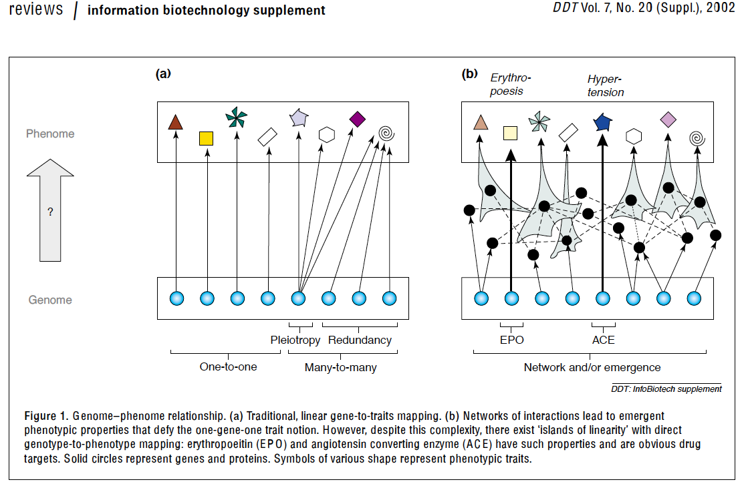
Simple systems embedded within complex systems: “islands of linearity”
(Sui Huang, DDT, vol 7, No 20 (Suppl), 2002)

Slide 6
Simple systems embedded within complex systems: “islands of linearity”
Example – Successful Drugs
(Sui Huang, DDT, vol 7, No 20 (Suppl), 2002)

Slide 7

Simple systems embedded within complex systems: “islands of linearity”
Example – Single Gene Knockout Phenotypes
Insights into the Network-Level Organization of Cells
• 1/3 yeast single-gene gene knockouts yield a visible phenotype
• roughly 1 in 100 double-gene KO’s yield a phenotype
• roughly 1 in 1000 triple-gene phenotypes yield a phenotype

Slide 8
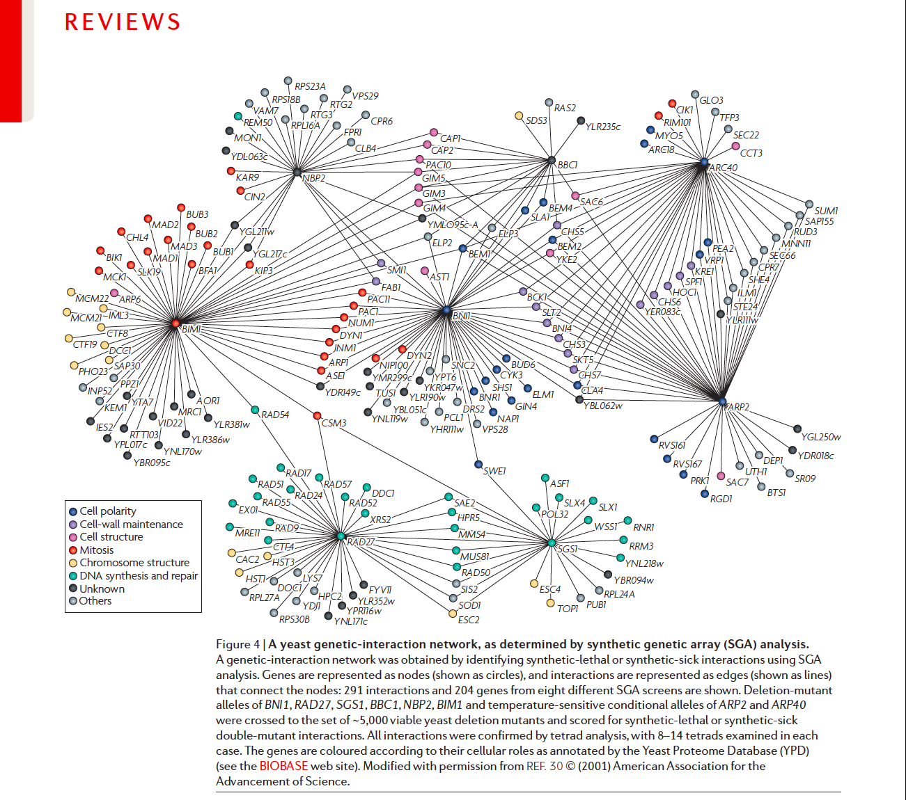
Boone et al, Nat Rev Genet, 2007

Slide 9
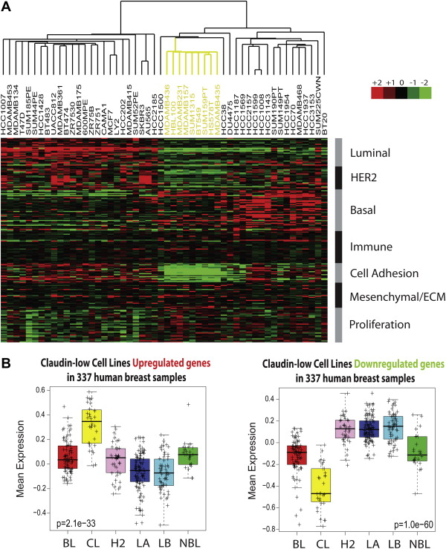
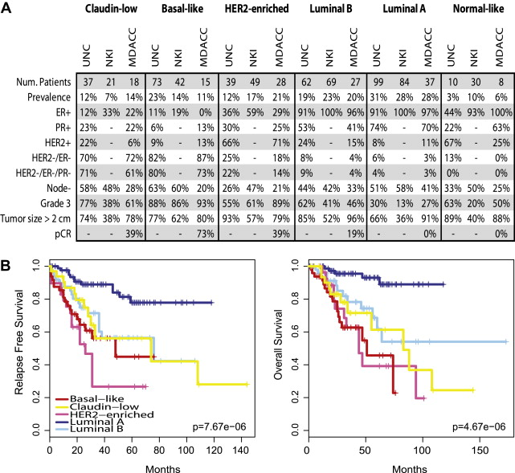
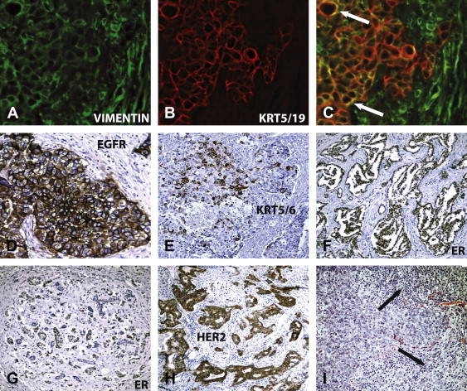
Simple systems embedded within complex systems: “islands of linearity”
Example – Breast Cancer Gene Expression Profiles
Prat and Perou. “Deconstructing the molecular portraits of breast cancer.” Molecular Oncology. (2011).

Slide 10
Some Approaches for Analyzing Systems
Simple/Complicated Systems
- Differential Equations-based models
- ex: bacterial DNA damage response
- Clustering, Correlation analysis, etc.
Complex Systems
- sometimes, Simple systems can be embedded in Complex ones
→ “islands of linearity”
- sometimes, simple rules can lead to complex behaviors
- complex systems modeling uses alternative modeling tools
→ ex: agent-based modeling

Slide 11
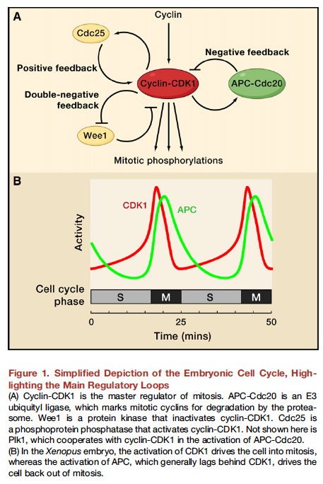
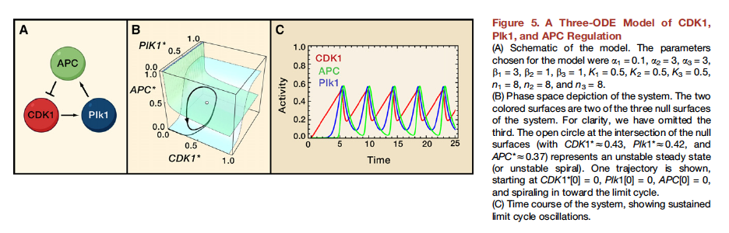
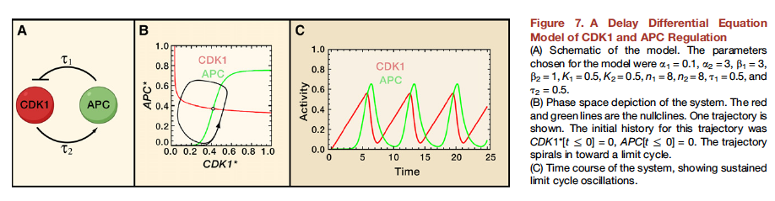
Simple Sub-Systems: Boolean and Differential Equation models can be used to create oscillatory behavior
Ferrell JE et al., Cell, vol 144, 2011

Slide 12
Working out the oscillatory dynamics of a simple boolean system of inhibitory interactions:
A
C
A
C
B
B
There are three nodes in this boolean model: A, B and C, and each node has a rule when being updated in each time step: A: not B, B: not C, C: not A.
There are three nodes in this boolean model: A, B and C, and each node has a rule when being updated in each time step: A: not B, B: not C, C: A.

Slide 13
Working out the oscillatory dynamics of a simple boolean system of inhibitory interactions:
A
C
A
C
B
B
Time | [A] | [B] | [C]
0 | 1 | 1 | 1
1 | 0 | 0 | 0
2 | 1 | 1 | 1
3 | 0 | 0 | 0
4 | 1 | 1 | 1

Slide 14
Working out the oscillatory dynamics of a simple boolean system of inhibitory interactions:
A
C
A
C
B
B
Time | [A] | [B] | [C]
0 | 1 | 1 | 1
1 | 0 | 0 | 0
2 | 1 | 1 | 1
3 | 0 | 0 | 0
4 | 1 | 1 | 1
Time | [A] | [B] | [C]
0 | 0 | 1 | 0
1 | 1 | 0 | 1
2 | 0 | 1 | 0
3 | 1 | 0 | 1
4 | 0 | 1 | 0

Slide 15
Working out the oscillatory dynamics of a simple boolean system of inhibitory interactions:
A
C
A
C
B
B
Time | [A] | [B] | [C]
0 | 1 | 1 | 1
1 | 0 | 0 | 0
2 | 1 | 1 | 1
3 | 0 | 0 | 0
4 | 1 | 1 | 1
Time | [A] | [B] | [C]
0 | 1 | 1 | 1
1 | 0 | 0 | 1
2 | 1 | 0 | 0
3 | 1 | 1 | 1
4 | 0 | 0 | 1
Time | [A] | [B] | [C]
0 | 0 | 1 | 0
1 | 1 | 0 | 1
2 | 0 | 1 | 0
3 | 1 | 0 | 1
4 | 0 | 1 | 0

Slide 16
Working out the oscillatory dynamics of a simple boolean system of inhibitory interactions:
A
C
A
C
B
B
Time | [A] | [B] | [C]
0 | 1 | 1 | 1
1 | 0 | 0 | 0
2 | 1 | 1 | 1
3 | 0 | 0 | 0
4 | 1 | 1 | 1
Time | [A] | [B] | [C]
0 | 1 | 1 | 1
1 | 0 | 0 | 1
2 | 1 | 0 | 0
3 | 1 | 1 | 1
4 | 0 | 0 | 1
Time | [A] | [B] | [C]
0 | 0 | 1 | 1
1 | 0 | 0 | 0
2 | 1 | 1 | 0
3 | 0 | 1 | 1
4 | 0 | 0 | 0
Time | [A] | [B] | [C]
0 | 0 | 1 | 0
1 | 1 | 0 | 1
2 | 0 | 1 | 0
3 | 1 | 0 | 1
4 | 0 | 1 | 0

Slide 17
Working out the oscillatory dynamics of a simple boolean system of inhibitory interactions:
A
C
A
C
B
B
Time | [A] | [B] | [C]
0 | 1 | 1 | 1
1 | 0 | 0 | 0
2 | 1 | 1 | 1
3 | 0 | 0 | 0
4 | 1 | 1 | 1
Time | [A] | [B] | [C]
0 | 1 | 1 | 1
1 | 0 | 0 | 1
2 | 1 | 0 | 0
3 | 1 | 1 | 1
4 | 0 | 0 | 1
Time | [A] | [B] | [C]
0 | 0 | 1 | 1
1 | 0 | 0 | 0
2 | 1 | 1 | 0
3 | 0 | 1 | 1
4 | 0 | 0 | 0
Time | [A] | [B] | [C]
0 | 0 | 1 | 0
1 | 1 | 0 | 1
2 | 0 | 1 | 0
3 | 1 | 0 | 1
4 | 0 | 1 | 0
Time | [A] | [B] | [C]
0 | 0 | 0 | 1
1 | 1 | 0 | 0
2 | 1 | 1 | 1
3 | 0 | 0 | 1
4 | 1 | 0 | 0

Slide 18
Working out the oscillatory dynamics of a simple boolean system of inhibitory interactions:
A
C
A
C
B
B
Time | [A] | [B] | [C]
0 | 1 | 1 | 1
1 | 0 | 0 | 0
2 | 1 | 1 | 1
3 | 0 | 0 | 0
4 | 1 | 1 | 1
Time | [A] | [B] | [C]
0 | 1 | 1 | 1
1 | 0 | 0 | 1
2 | 1 | 0 | 0
3 | 1 | 1 | 1
4 | 0 | 0 | 1
Time | [A] | [B] | [C]
0 | 0 | 1 | 1
1 | 0 | 0 | 0
2 | 1 | 1 | 0
3 | 0 | 1 | 1
4 | 0 | 0 | 0
Time | [A] | [B] | [C]
0 | 0 | 1 | 0
1 | 1 | 0 | 1
2 | 0 | 1 | 0
3 | 1 | 0 | 1
4 | 0 | 1 | 0
Time | [A] | [B] | [C]
0 | 0 | 0 | 1
1 | 1 | 0 | 0
2 | 1 | 1 | 1
3 | 0 | 0 | 1
4 | 1 | 0 | 0
Time | [A] | [B] | [C]
0 | 1 | 1 | 0
1 | 0 | 1 | 1
2 | 0 | 0 | 0
3 | 1 | 1 | 0
4 | 0 | 1 | 1

Slide 19
Working out the oscillatory dynamics of a simple boolean system of inhibitory interactions:
A
C
A
C
B
B
Time | [A] | [B] | [C]
0 | 1 | 1 | 1
1 | 0 | 1 | 0
2 | 1 | 0 | 1
3 | 0 | 1 | 0
4 | 1 | 0 | 1
Time | [A] | [B] | [C]
0 | 1 | 1 | 1
1 | 0 | 0 | 1
2 | 1 | 0 | 0
3 | 1 | 1 | 1
4 | 0 | 0 | 1
Time | [A] | [B] | [C]
0 | 0 | 1 | 1
1 | 0 | 0 | 0
2 | 1 | 1 | 0
3 | 0 | 1 | 1
4 | 0 | 0 | 0
Time | [A] | [B] | [C]
0 | 1 | 1 | 1
1 | 0 | 0 | 0
2 | 1 | 1 | 1
3 | 0 | 0 | 0
4 | 1 | 1 | 1
Even number of inhibitory interactions → Bi-Stable Behavior
Odd number of inhibitory interactions → Oscillatory Behavior

Slide 20

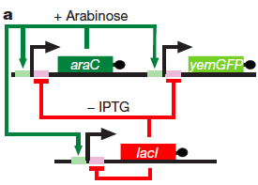
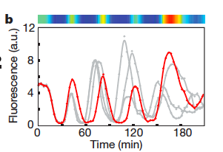
“Blinking” Green Fluorescent Protein in E. Coli

